Slide 1
NBA Players Analysis
Group 9 members :
Ayyappa Sumanth Bhuma
Khushboo Saxena
Kirat Saran
Shreya Balan Nambiar

Slide 2

Dataset Insights -
Dataset was taken from Kaggle
Link to the dataset: https://www.kaggle.com/datasets/justinas/nba-players-data?select=all_seasons.csv
Data ranging from 1996 - 2021
No of rows : 12305
No of columns : 22
Some important features include player's physical characteristics, percentage of shooting efficiency, average points scored, net rating, assists, rebounds, etc.
Notes:
To replace this picture, just select and delete it. Then use the Insert Picture icon to replace it with one of your own!

Slide 3
Objectives
See impact of height and weight of a player when it comes to their performance.
Predict if the player will get drafted in the upcoming round.
Determine if a player is offensive.
Understand specific performance characteristics of a player that helped their gameplay in a particular season.

Slide 4
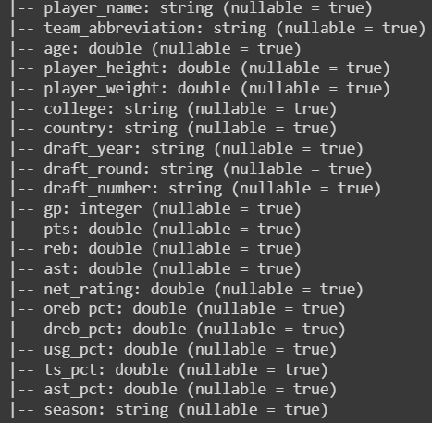
Feature Engineering
Replaced Undrafted with 0 for draft_year, draft_round and draft_number columns
Converted draft_round and draft_number to integer type and draft_year to datetime type
Standardized the numerical columns

Slide 5
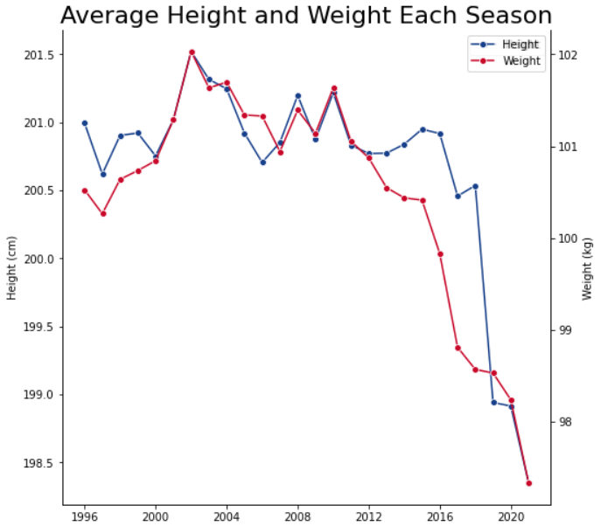
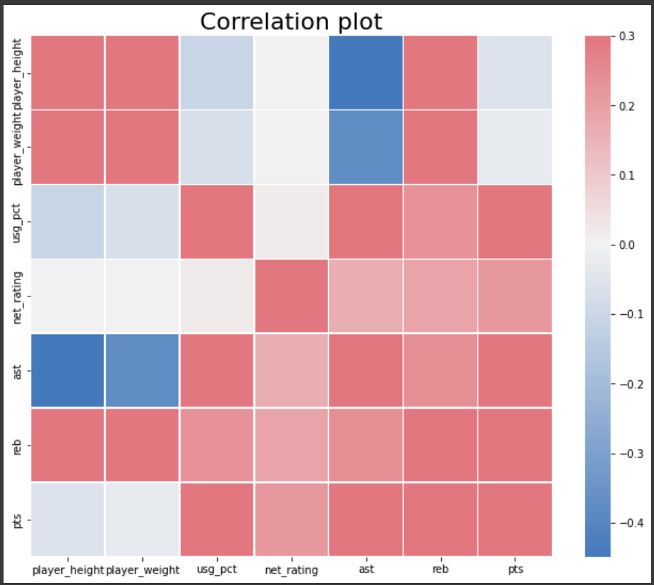
Physical Characteristics
Decreasing trend in average height and weight
Taller and heftier players get more rebounds and less assists
Physical characteristics have little impact on points scored or net rating of a player

Slide 6
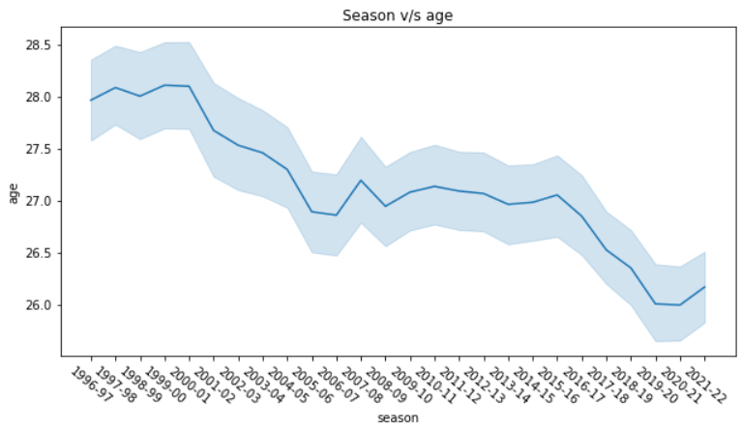
Season v/s Age

Slide 7
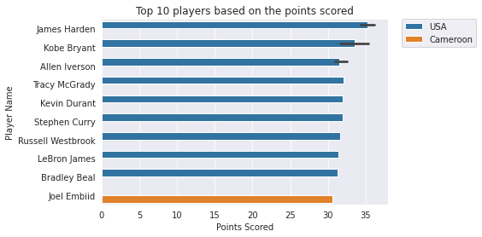
Top 10 players

Slide 8
Processing and Modelling
Determining if player is offensive
Logistic regression

Slide 9
Shooting Efficiency
Measure of shooting efficiency that takes into account free throws, 2 and 3 points.
Features like percentage of available offensive rebounds, average assists, average points and percentage of assists.
Threshold value is set to the mean value of the players shooting efficiency.
Used logistic regression to determine if the player is offensive.

Slide 10
Interpreting Net rating
Random Forest Regression
Linear Regression

Slide 11
Net Rating
Team's point differential per 100 possessions while the player is on the court
Features like physical stats, team, points scored, assists, and rebounds are considered for modeling
Calculated feature importance of the variables using random forest regressor for each season to observe the trend in importance given to each variable

Slide 12
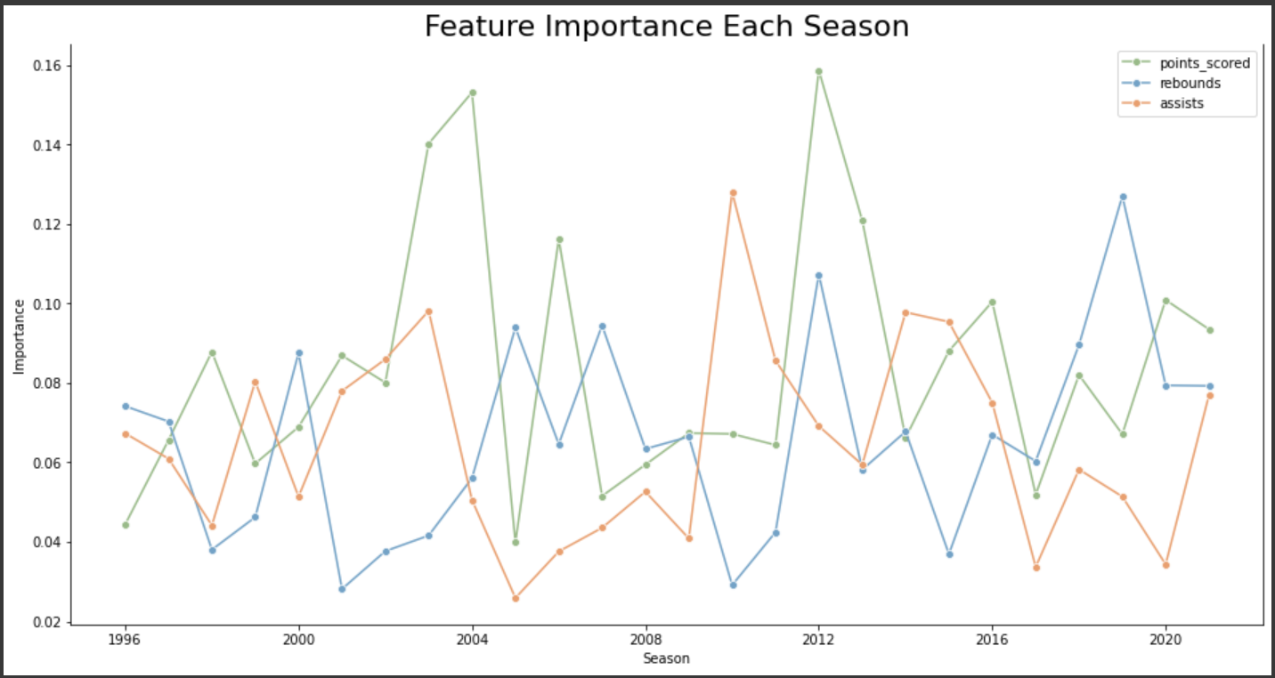
Feature Importance

Slide 13
Limitations and Future Scope
Accuracy
Does not take into consideration other factors that contribute to the success of the player.
Basketball is a team sport, and the data we have is of individual players, not the performance of the team.
The way a player performs doesn't always indicate how skilled they are.
Data that takes skills into consideration can be used to understand combinations that would improve overall results.

Slide 14
Conclusion and Interesting finds
Overall, this was a very fun dataset to work with, and we are pleasantly surprised with the results.
It is quite difficult to determine if a players will be drafted or not, and there appear to be other factors at play that are not necessarily included in this dataset.
Other factors which may influence could potentially be – body fat percentage, hand width, standing reach, lane agility, shuttle run etc.

